Slide 1
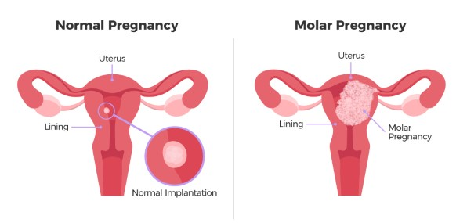
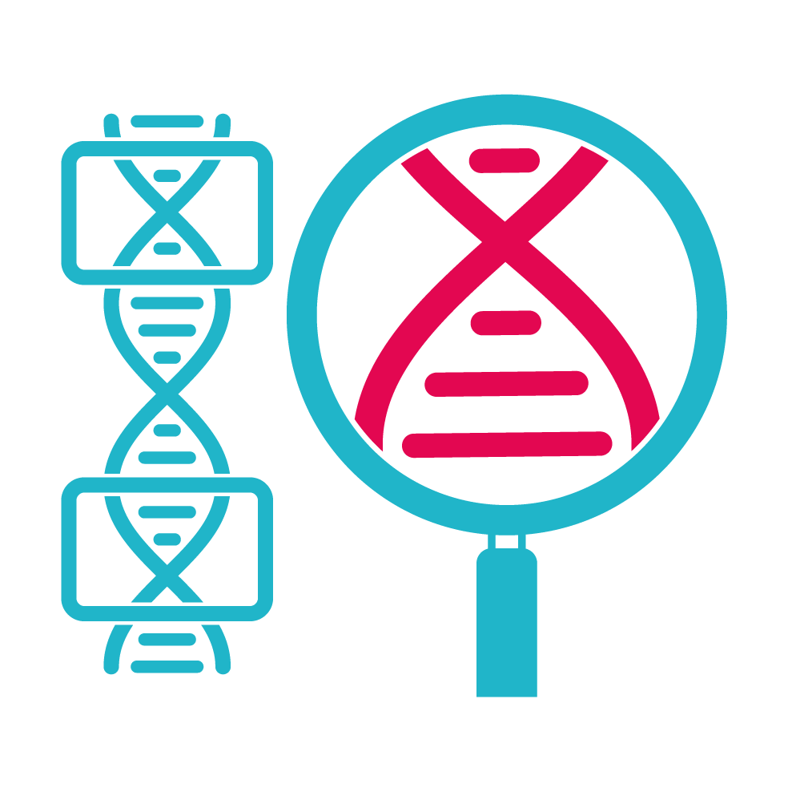

Detection of copy number variation from whole-exome sequencing data of complete hydatidiform mole with co-existing fetus (CHMCF)
jiajun Cui
Supervised by Chen Li
>
>
>
>

Slide 2

Background
Hydatidiform mole (HM):
Rare complication of pregnancy with abnormal growth of trophoblasts
https://radiologykey.com/gestational-trophoblastic-neoplasia/
Notes:
First I ll introduce some basic concepts about this disease. And the hydatidiform mole is a kind of rare complication of preganancy with abnormal hyper growth of trophoblasts, which are cells that normally develop into placenta

Slide 3
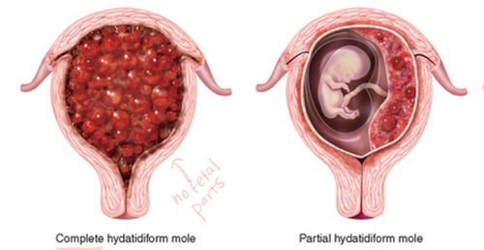
Background
Subtype:
Complete hydatidiform mole (CHM): Partial hydatidiform mole (PHM):
No fetus Partially formed fetus
https://radiologykey.com/gestational-trophoblastic-neoplasia/
Notes:
There are two types of hm, complete molar pregnancy and partial molar pregnancy
Two type: in chm, there is no accompanying viable fetus. While In phm, a partially formed but not viable fetus or some identifiable fetal tissues are present.
Another key genomic feature about the two hm is that a complete hydatidiform mole is derived from abnormal fertilization of two copies of sperm and an ovum that lacks maternal DNA, thus it is diploid, and A partial hydatidiform mole is triploid because of the fertilization of two copies of sperm and a normal ovum with maternal nuclear.

Slide 4
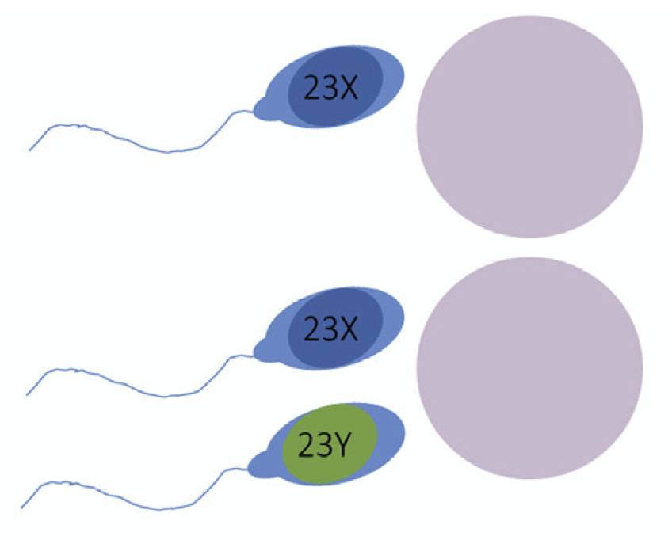
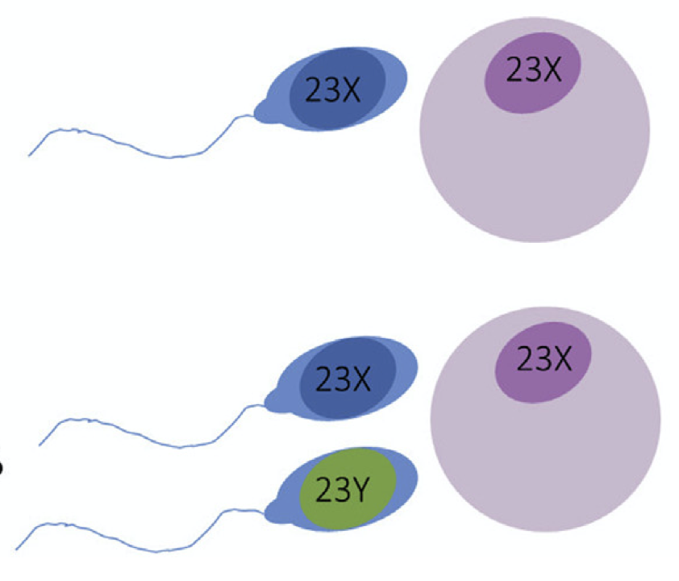
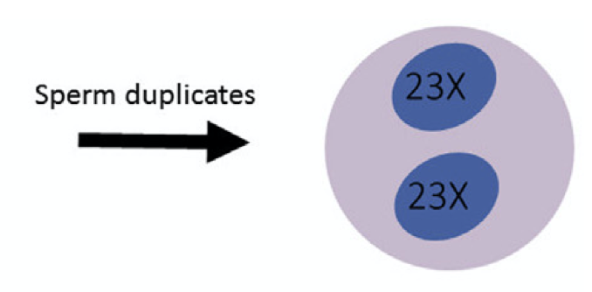
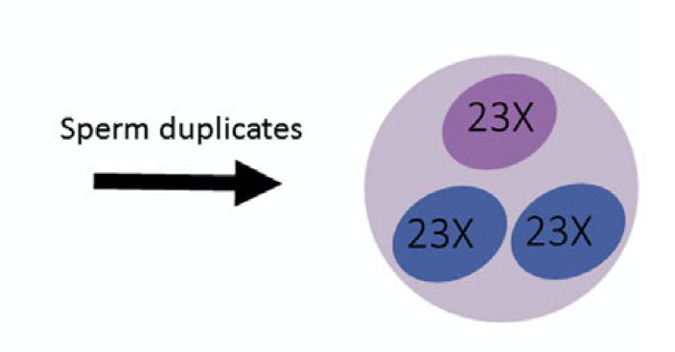

Background
Subtype:
Complete molar pregnancy (CHM): Partial molar pregnancy (PHM):
No fetus Partially formed fetus
Diploid (46,XX/XY) Triploid (69,XXY)
2 sperm + empty egg
2 sperm + 1 egg
https://en.wikipedia.org/wiki/Molar_pregnancy
Notes:
Genetically, the cause of HM is the abnormal fertilization between 2 sperms and either one empty egg in CHM or one complete egg in PHM. As a result, the CHM is diploid and the PHM is triploid

Slide 5
Background
HM clinical symptoms:
Vaginal bleeding
Larger uterus and/or ovaries
More vomiting
High blood pressure
High human chorionic gonadotropin (hCG)
Notes:
For the clinical symptoms, many patients have vaginal bleeding…, and all of them present a high level of hCG

Slide 6
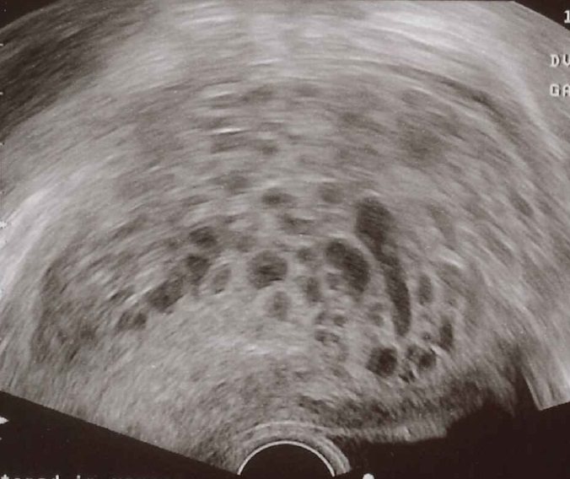
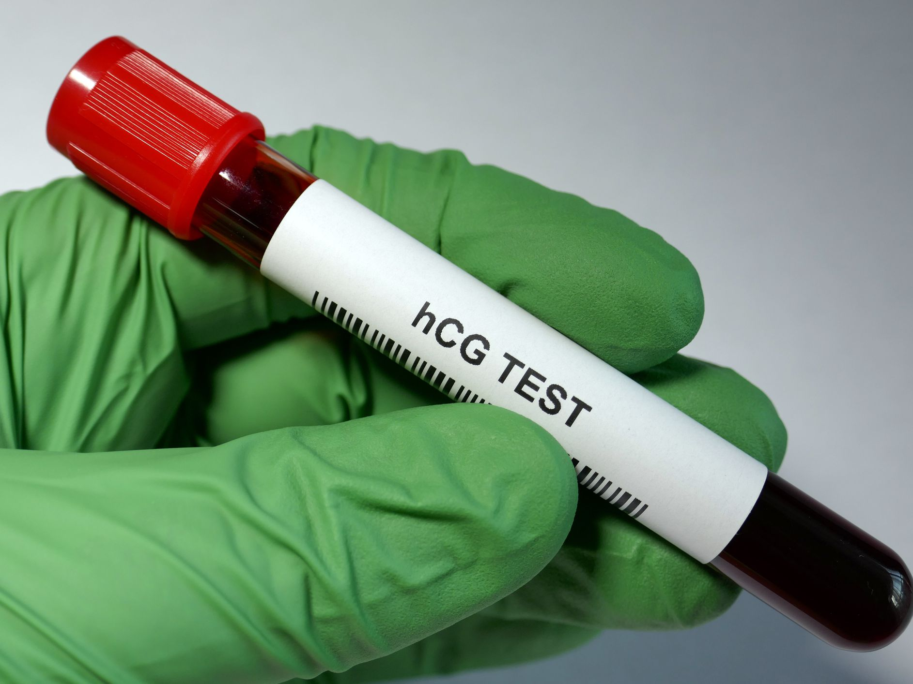
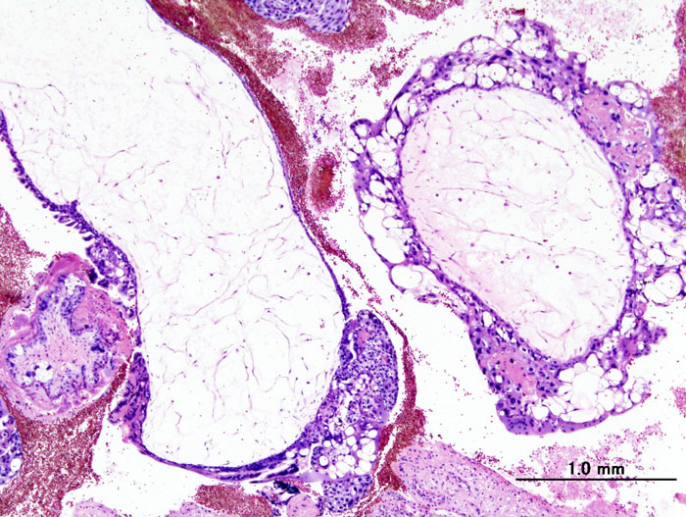
Background
CNV
HM clinical diagnosis:
Ultrasound
High human chorionic gonadotropin (hCG)
Histopathological examination
https://radiopaedia.org/cases/complete-hydatidiform-mole?lang=gb
Notes:
And for the current diagnosis, it usually comes a combination of ultrasound, hCG blood test and eventually the histopathological examination

Slide 7


Aim of my project
1. HM/CHM/CHMCF early diagnosis
Any Biomarker?
2. Few previous research regarding structure variants in CHM
Any novel CNVs involved in the pathology of CHM?
Notes:
But there is no commonly accepted biomarker for HM early diagnosis, which is very important for the treatment selection of pregnancy complication. And there is few previous reseach detecting the structure vairants such as the copy number variants in CHM. Therefore, in my project, with the wes data of two cases of CHMCF, I would like to investigate whether there is any CNV can be the candidate of CHM biomarker or involved in the pathology of CHM.

Slide 8
Aim of my project
Detecting Copy Number Variants (CNVs) involved in the pathology of CHMCF from Whole-Exome Sequencing (WES) data
CHMCF
WES
CNV
CNVkit
>
>
>
>
conifer
Notes:
Detecting Copy Number Variants (CNVs) from Whole-Exome Sequencing data (WES) with two commonly used tools called CNVkit and Conifer

Slide 9
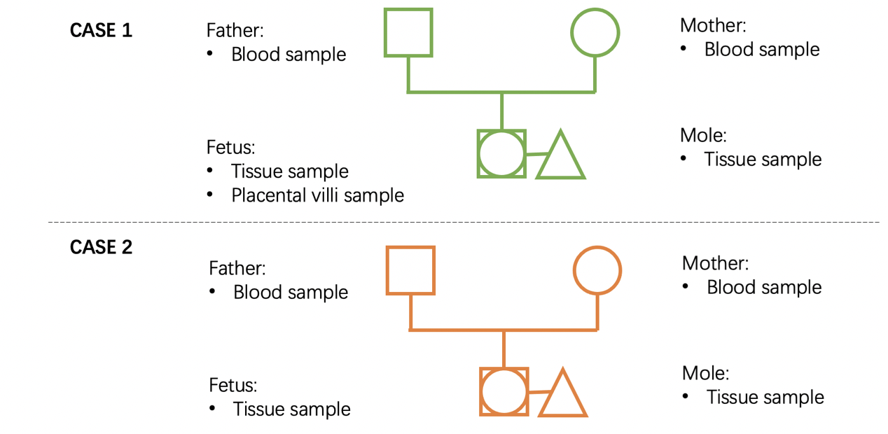

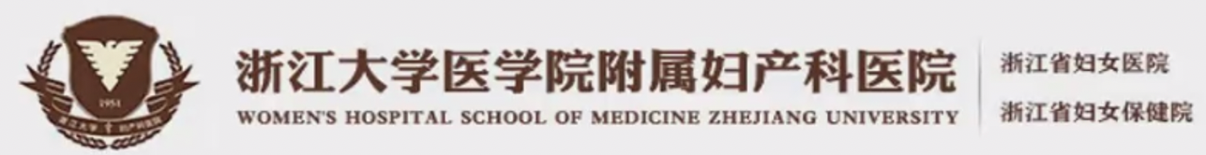
Methodology
Data:
Placental villi sample
Notes:
The data used were from Womens hospital of Zhejiang University, they provided two cases of CHMCF, with wes data of father, mother, co-existing fetus and mole. In case 1, the data of fetus tissue was provided, but in case2, only the placental villi data was given.

Slide 10
Methodology
Clinical report:
Case Case 1 (22 years old): Case2 (34 years old):
CHM 4.0*3.5*2.5cm 8.3*9.5*6.7cm
Gestational 13w+5 10w+6
weeks
Symptoms vaginal bleeding, hyper vomiting and high hCG level
hCG level 313,694 IU/L 924,904 IU/L
Notes:
And here is the clinical brief of two CHMCF cases, they all presented severe symptoms including …, and they chose to do the operation to clear the palace Around the second month

Slide 11
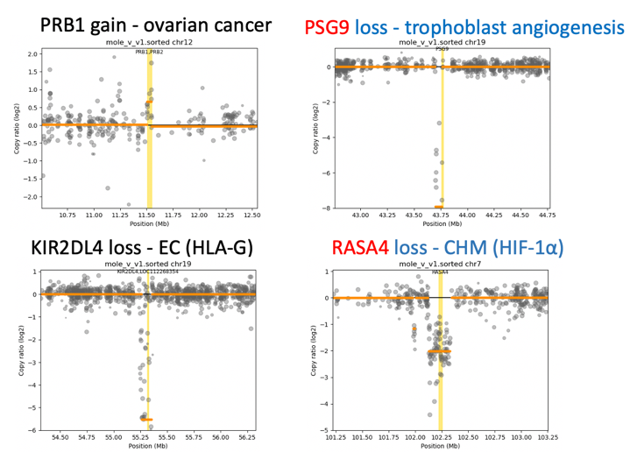
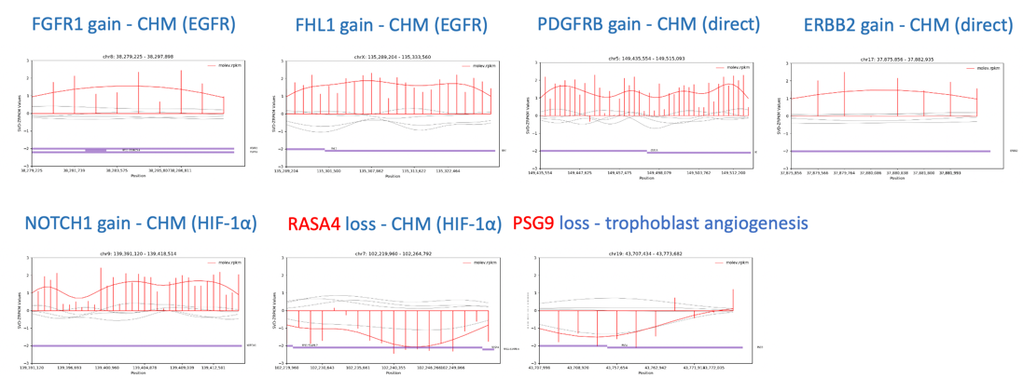

Slide 12
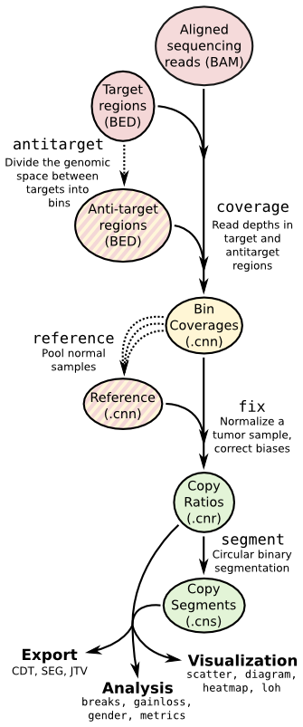
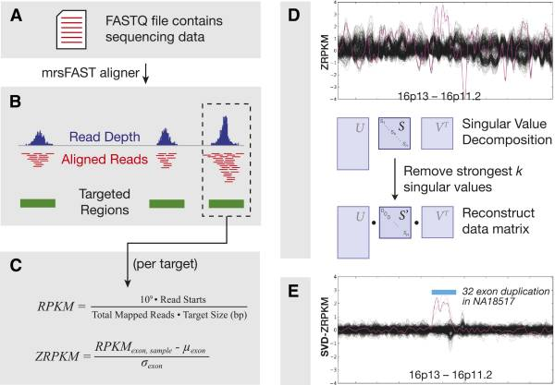
Methodology
CNVkit: Conifer:
tumor-normal paired
pooling
Notes:
For the cnv calling tools, I chose two tools, CNVkit and conifer, after amount of literature review, and the reason why I chose them is that, there are two frequently used patterns when you do the cnv calling. Based on wes data, tumor-normal paired and pooling. And these two tools are one of the best using this two patterns and the accuracy of them are around 90percent.
For the cnvkit, it consider both the target regions, in wes, the exome region and the anti-target regions to calculate the read depth of each bin in the target regions. And it generate the reference, which I used the fetus sample data as reference in my case, then eventally it output the copy ratios of each significant segments, you can export a tabl, do data visualization or use some cnvkit function to do analysis.
For the conifer, it calculate the read depth by calculate the RPKM in each sample and they use Z score the normalize the RPKM value. After that they perform SVD, singular value decomposition to remove the strong background and noisy in the Z-RPKM matrix to reduce the system erorr of you cnv calling result.

Slide 13

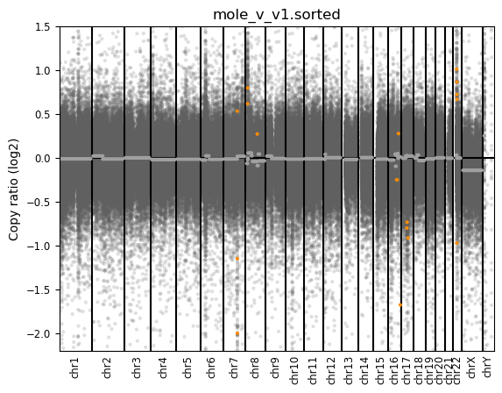
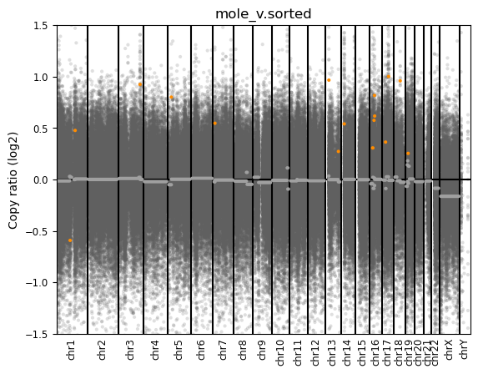
Result – overall
CNVkit overall landscape:
CNV scatter plot across chromosomes
Case1 HM
Case2 HM
0.3
0.3
-0.3
-0.3
Notes:
now comes the main result of data analysis
Overall, CNVkit provides a landascape of CNV across all the chromosomes
I Set a threshold of point three when detect the cnvs, which are presented as orange points

Slide 14
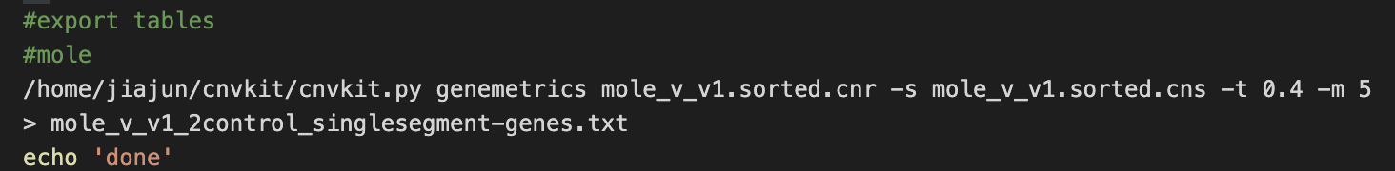
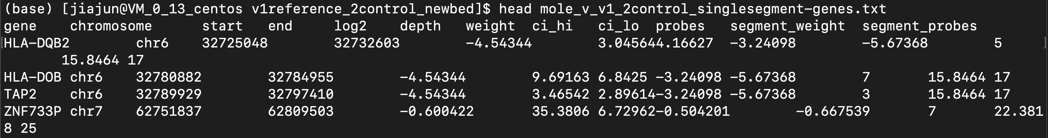
Result
CNVkit gene table exportation:
Found gene-level gains and losses
mole_v_v1_2control_singlesegment-genes.txt
mole_v_v2_1control_singlesegment-genes.txt
Notes:
The cnvkit output the txt files containing detected CNVs with gene name, chromosome start end and log2 ratio of copy number and other information

Slide 15
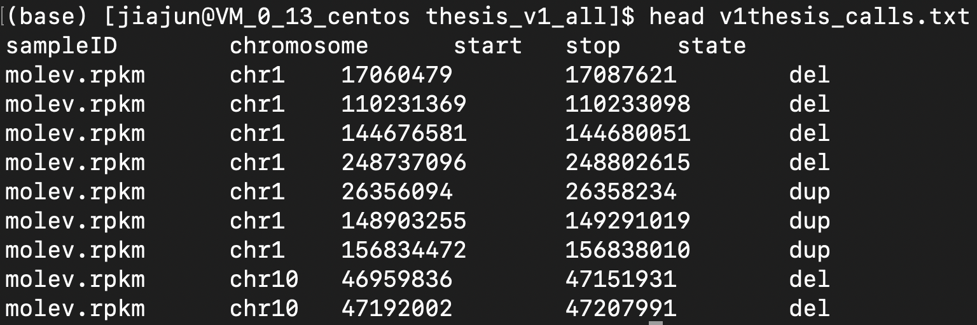

Result
Conifer gene table exportation:
Found gene-level gain and loss regions
v1thesis_calls.txt
Found gene-level gains and losses
v2thesis_calls.txt
Notes:
In the same way, conifer generate the regions of CNV and I used the UCSC table browser to transform DNA region into gene list.

Slide 16
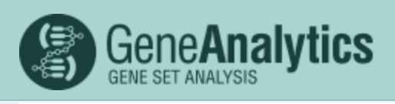
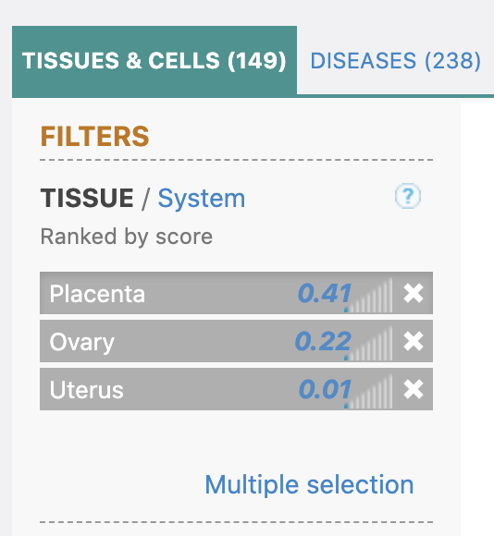
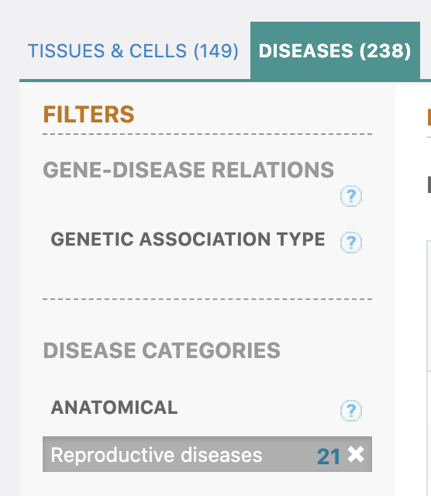



Result – case 1
CNVkit & Conifer filtration:
199 CNVs from CNVkit
8 CNVs
4 CNVs
145 CNVs from Conifer
30 CNVs
7 CNVs
Notes:
And here finally is the result of case1, I detected 4 cnvs using CNVkit and 7 using Conifer by filtration with gene card and literature review in pubmed

Slide 17
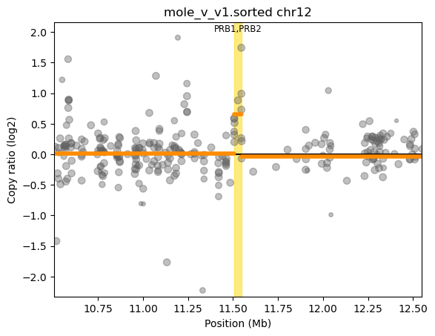
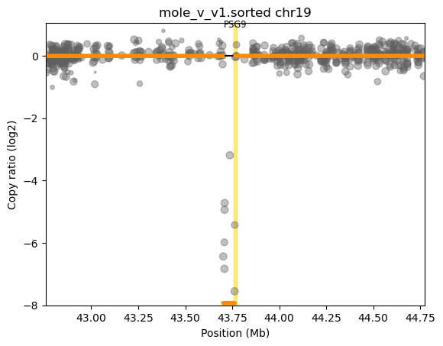
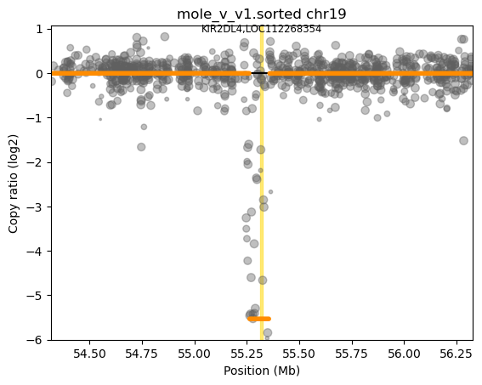
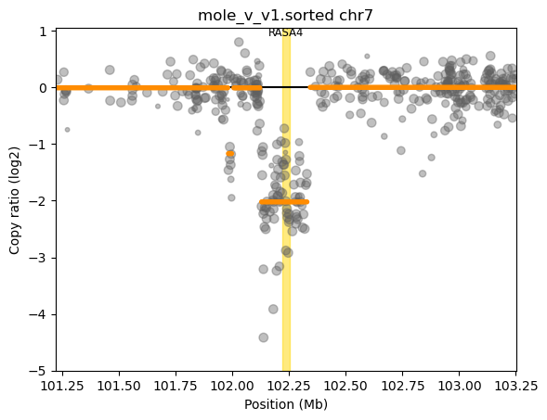
Result – case 1
CNVkit visualization:
PRB1 gain - ovarian cancer
PSG9 loss - trophoblast angiogenesis
KIR2DL4 loss - EC (HLA-G)
RASA4 loss - CHM (HIF-1α)
Blue indicates CHM associated CNV
Notes:
I will briefly introduce the detected cnvs, some of them are related to reproductive diseases, others are involved in the CHM pathology directly or indirectly, which you can see, that in blue font

Slide 18
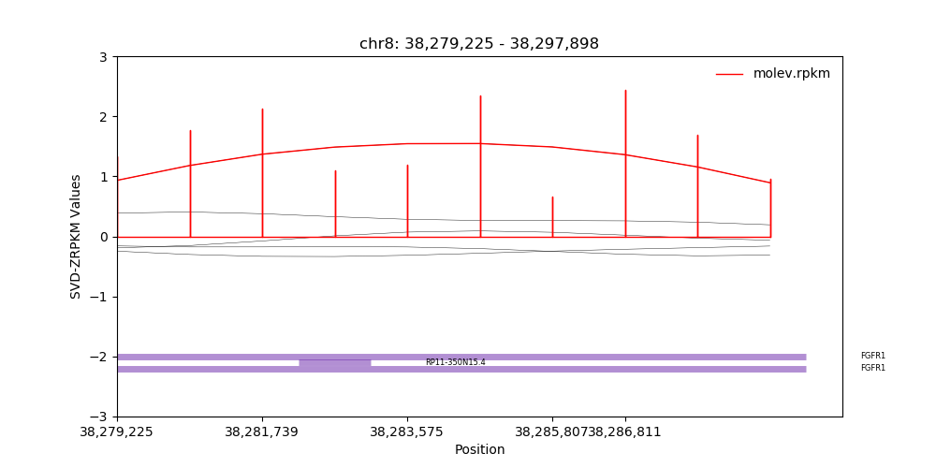
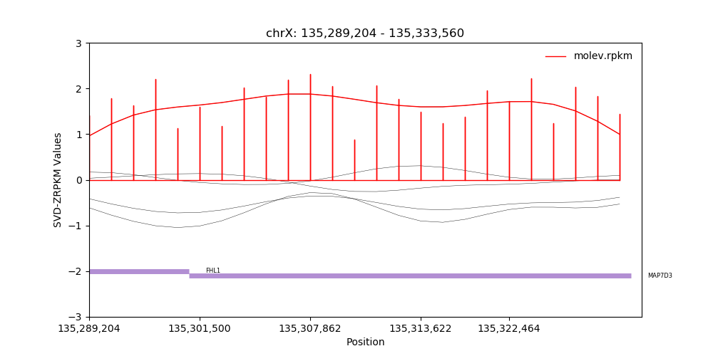
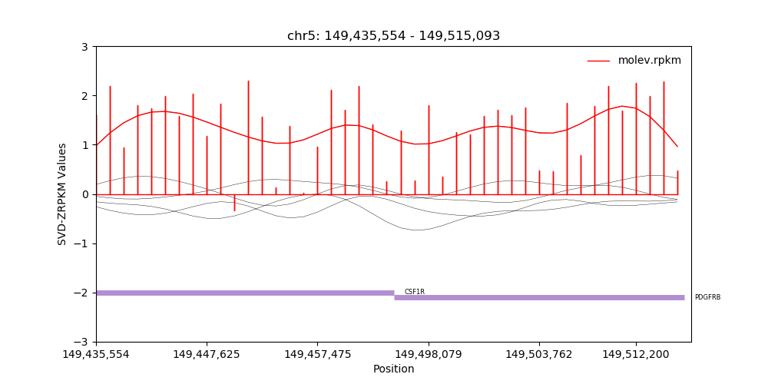
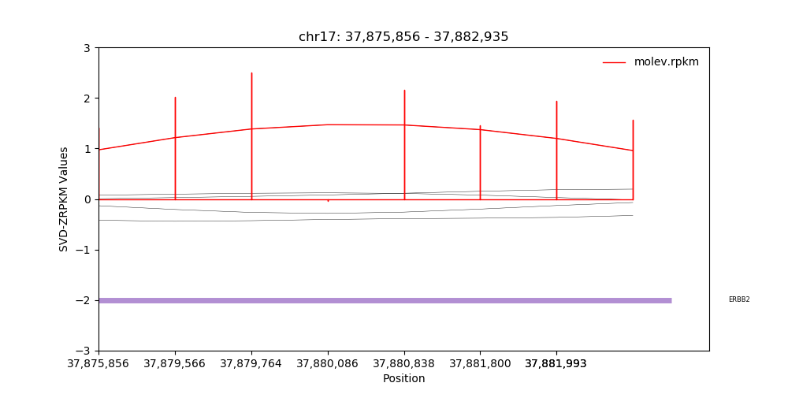
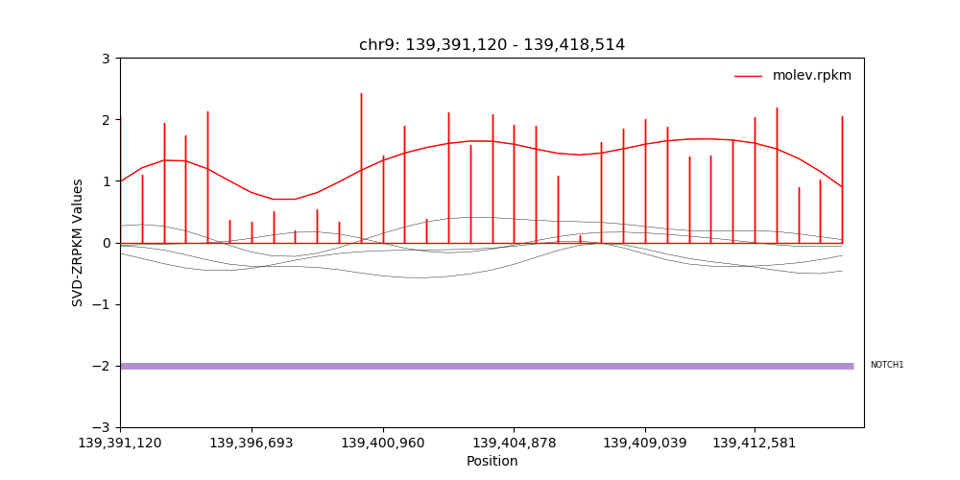
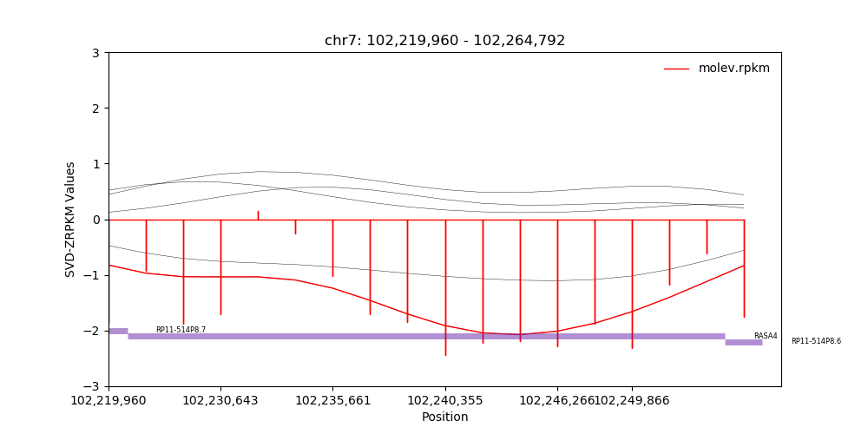
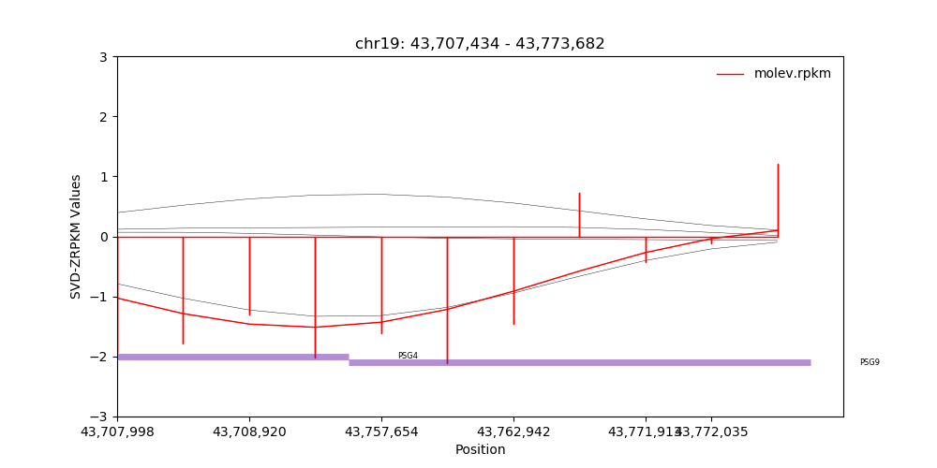
Result – case 1
Conifer visualization:
FGFR1 gain - CHM (EGFR)
FHL1 gain - CHM (EGFR)
PDGFRB gain - CHM (direct)
ERBB2 gain - CHM (direct)
NOTCH1 gain - CHM (HIF-1α)
RASA4 loss - CHM (HIF-1α)
PSG9 loss - trophoblast angiogenesis
Blue indicates CHM associated CNV
Notes:
The conifer result is similar as that of cnvkit, PSG9 and RASA4 cnv loss are detected in both cnvkit and conifer.

Slide 19
Result – case 2
CNVkit & Conifer filtration:
225 CNVs from CNVkit
30 CNVs
8 CNVs
145 CNVs from Conifer
11 CNVs
3 CNVs
Notes:
For the case2, 8 cnvs were captured by cnvkit and 3 by conifer

Slide 20
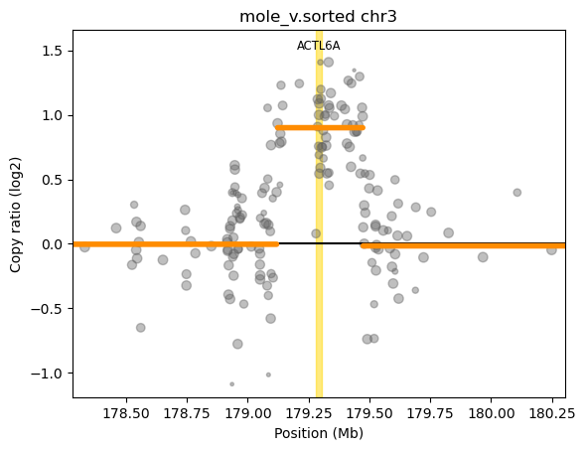
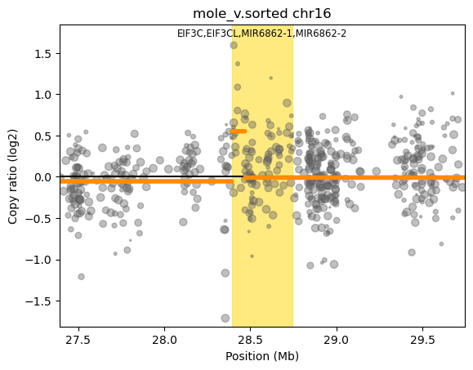
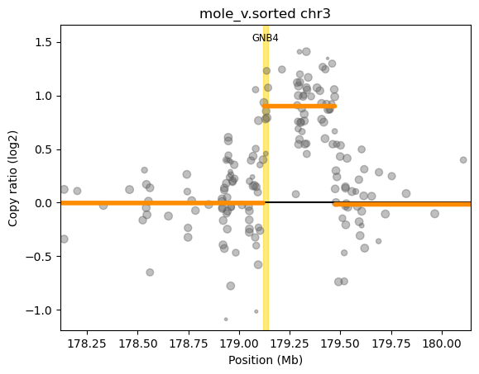
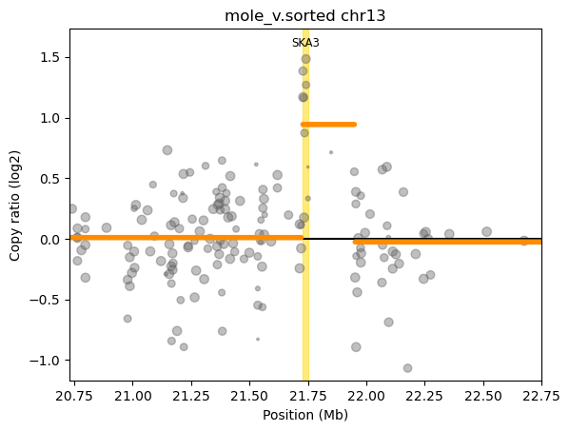
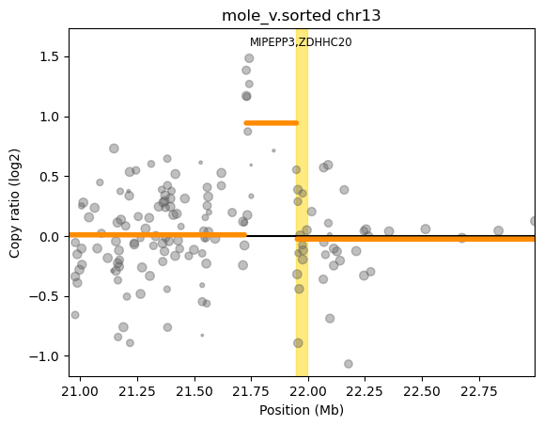
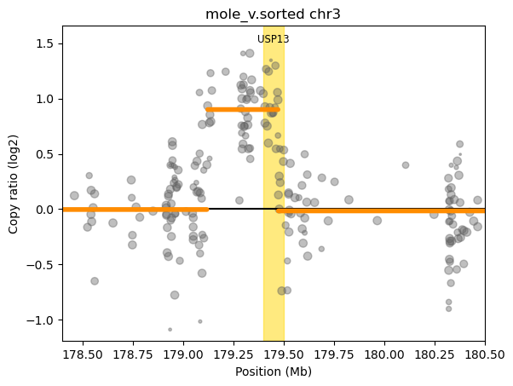
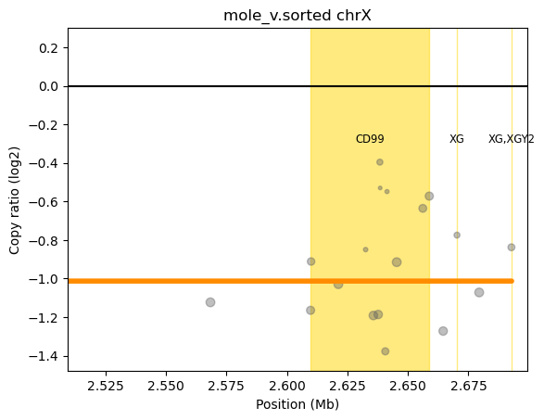
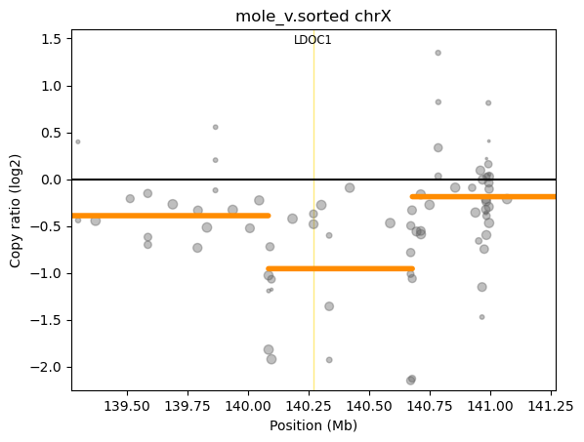
Result – case 2
CNVkit visualization:
ACTL6A gain - ovarian cancer
EIF3C gain - ovarian cancer
GNB4 gain - breast cancer
SKA3 gain - breast cancer
ZDHHC20 gain - CHM (EGFR)
USP13 gain - CHM (EGFR)
CD99 loss – CHM (direct)
LDOC1 loss - preeclampsia
Notes:
Here is the visuallizaiton again,

Slide 21
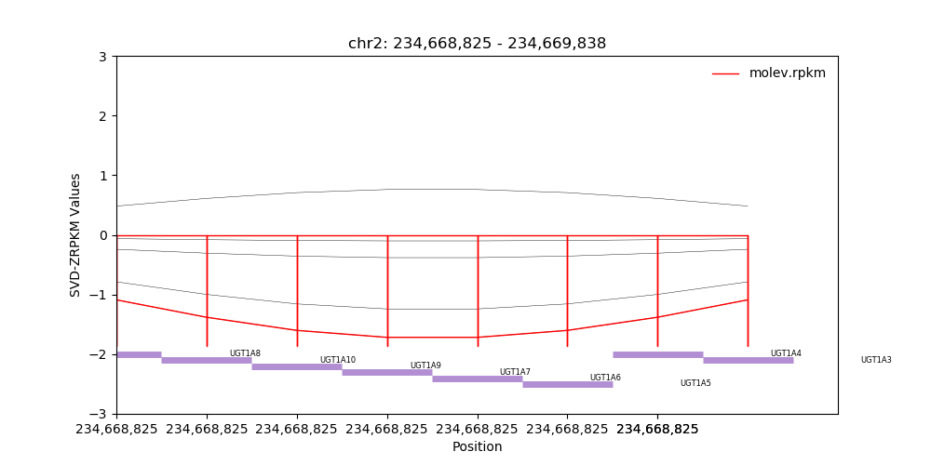
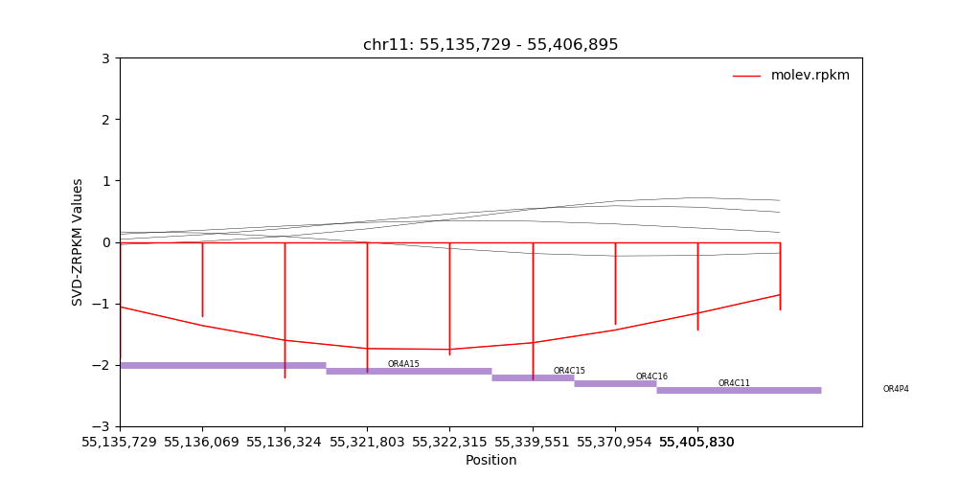
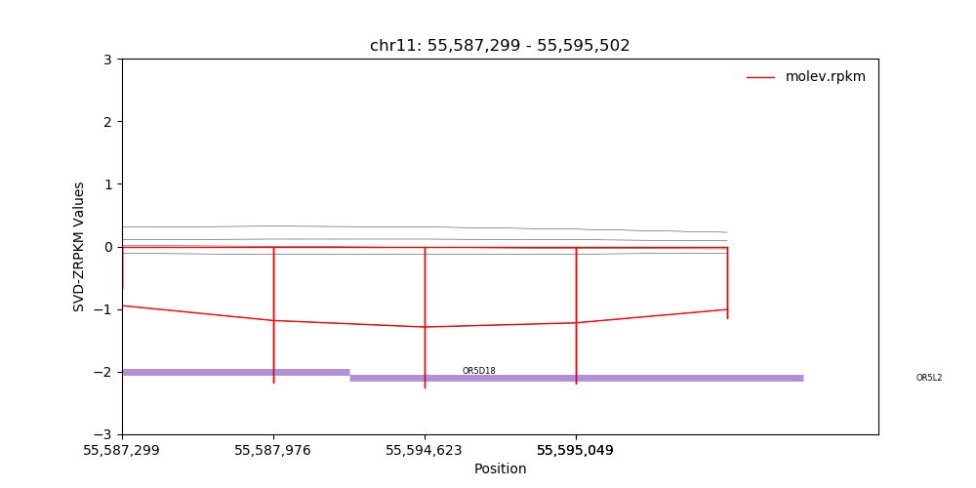
Result – case 2
Conifer visualization:
UGT1A6 loss - preeclampsia
OR4C11 loss - breast cancer
OR4P4 loss - breast cancer
Blue indicates CHM associated CNV
Notes:
And only three cnv losses were detected by conifer in case2

Slide 22
Discussion
Potential general biomarker for reproductive diseases (ovarian cancer, breast cancer and preeclampsia):
Case1: PRB1 RASA4 KIR2DL4
Case2: ACTL6A GNB4 EIF3C IDOC1 SKA3 OR4C11 OR4P4
Indirect HM pathologic CNVs (HIF1-alpha and EGFR):
Case1: PSG9 RASA4 FGFR1 FHL1 NOTCH1
Case2: ZDHHC20 USP13
Direct HM pathologic CNVs:
Case1: PDGFRB ERBB2
Case2: CD99
Notes:
So now I put all the results together, and obviously, they have something in common, some of them are related to reproductive disease, which may have the possibility as general biomarker for reproductive diseases, and there are also some genes related to the CHM pathology indirectly, in other words, they affect the expression of HiF1-alpha and EGFR, which are two vital factors in CHM.
And the most important is the three genes play a role directly in the pathology of hydatidiform mole. PDGFRB, ERBB2 and CD99. I think those CNVs are worth to be validated by some experiments, and do some further research.

Slide 23
Discussion
Why are few CNVs shared by two tools?
CNVkit & Conifer detected CNV length
CNVkit
Length mean: 21752.7kb
Conifer
Length mean: 5.6kb
Notes:
there are only two genes shared in Conifer and CNVkit in case1 and there is even no one shared in case2. So I wonder why are few CNVs shared by two tools? And when I plot the CNV length detected by two tools, I leant that the reason of the different results of two tools may be that, the CNVkit identified cnvs with a range of length, but conifer may focused on the detection of short CNVs. So I think the results from both tools should be considered to do further validation and research.

Slide 24
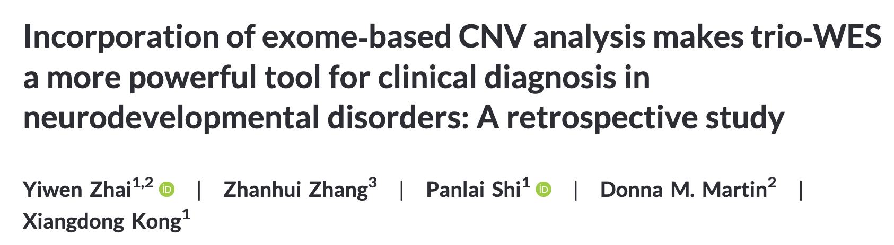
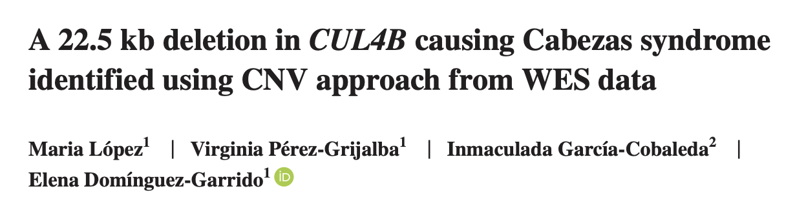
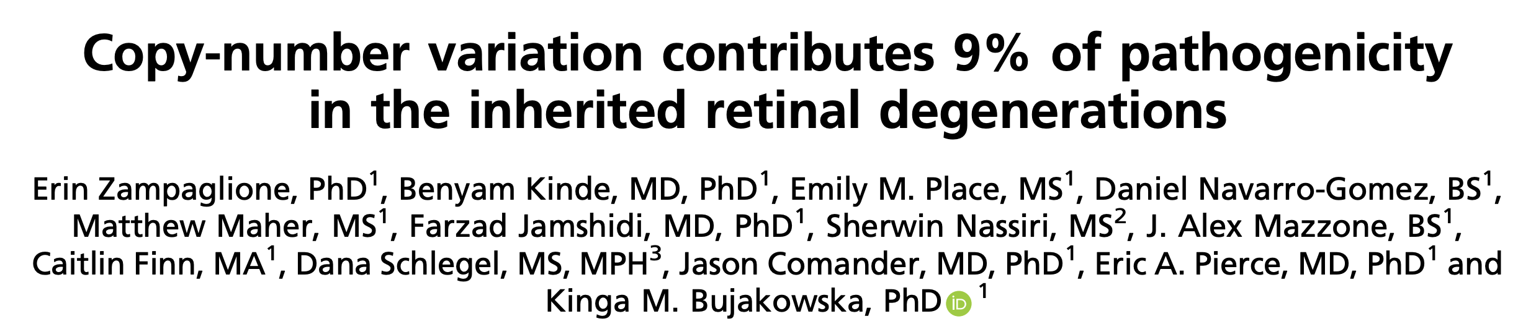
Limitation and Further improvement
Sample size
Validation
WES-based CNV detection in a cohort of 74 pedigrees
Detected CNVs of NGS data with CNVkit/gCNV
and validated with qPCR
Notes:
As for the further improvement, in my project, the first issue is the sample size, we only have two cases, but many convincing publication analyzed hundreds of cases
And the other issue is about the validation part. Nearly all the previous research detecting cnvs using NGS data included a validation of the CNVs with qPCR or gene array study

Slide 25
Conclusion
Detected 20 CNVs from WES data of two CHMCF cases
10 Potential biomarkers for reproductive diseases
7 causal CNVs indirectly associated with HM
3 causal CNVs directly associated with HM
Notes:
In conclusion, in this project, I detected 10 … 7 and 3 by analyzing the wes data from two CHMCF cases

Slide 26
Reference
Case1 gene
https://pubmed.ncbi.nlm.nih.gov/33065549/ PSG9
https://www.sciencedirect.com/science/article/pii/S0304383503006281?via%3Dihub PRB1
https://pubmed.ncbi.nlm.nih.gov/30639621/ FGFR1
https://pubmed.ncbi.nlm.nih.gov/33053208/ FHL1
https://pubmed.ncbi.nlm.nih.gov/8504434/ PDGFRB
https://pubmed.ncbi.nlm.nih.gov/19836147/ NOTCH1
https://pubmed.ncbi.nlm.nih.gov/19836147/ RASA4
https://pubmed.ncbi.nlm.nih.gov/12658752/ ERBB2

Slide 27
Reference
Case2 gene
https://www.ncbi.nlm.nih.gov/gene/86 https://pubmed.ncbi.nlm.nih.gov/31649264/ ACTLA6
https://pubmed.ncbi.nlm.nih.gov/30103729/ GNB4
https://pubmed.ncbi.nlm.nih.gov/31316002/ EIF3C
https://pubmed.ncbi.nlm.nih.gov/20630481/ CD99
https://pubmed.ncbi.nlm.nih.gov/25740878/ ZDHHC20
https://pubmed.ncbi.nlm.nih.gov/30975171/ USP13
https://pubmed.ncbi.nlm.nih.gov/32799774/ SKA3
https://pubmed.ncbi.nlm.nih.gov/25465229/ UGT1A6
https://www.ncbi.nlm.nih.gov/pmc/articles/PMC5356248/ OR4C11 OR4P4

Slide 28
Thank you!
Any questions?
>
>
>
>

Slide 29
Q&A
CHM or PHM?
STR and chr

